Slide 1


Slide 2

Midterm #1 Review Session
TA: Greydon Gilmore
Physiology 2130
Oct 23rd, 2019

Slide 3

Your TA reminding you…
Room Assignments:
Abba – Hwangin: Natural Sciences room 1
Ighani – Li: Natural Sciences room 7
Liang – Zia: Natural Sciences room 145
Breakdown (35 MC questions):
Excitable Cell ~ 13 questions
Sensory Physiology ~ 10 questions
Motor Control ~ 5 questions
Endocrine Physiology ~ 7 questions

Slide 4
What does it mean when an action potential will always have the same amplitude and duration? Doesn’t the action potential skyrocket and die down after it reaches the threshold?
What is meant by this is that the peak will always be around the same height
You cannot have a peak that is much lower or much higher than 30mV
With graded potentials you have varying amplitudes

Slide 5
Please answer in tutorial: how does the sodium potassium pump maintain the concentration gradients but not generate resting membrane potential? How then is resting membrane potential generated?
This has to do with the ions present, as well as the channels
All cells in the body have a resting membrane potential (RMP)
At electrochemical equilibrium:
No NET movement of ions (i.e. ions continue to enter and exit the cell at an equal rate)
The RMP is not generated by the Na⁺/K⁺ pump
Rather, it is mainly generated by K⁺ leaving the cell due to its high permeability (and Cl⁻ entering the cell easily)
This establishes an electrical potential difference across the membrane with inside negative with resect to the outside (-70 mV)
The Na⁺/K⁺ pump moves ions against gradients to return to RMP after AP
3 Na⁺ OUT and 2 K⁺ IN for each ATP

Slide 6
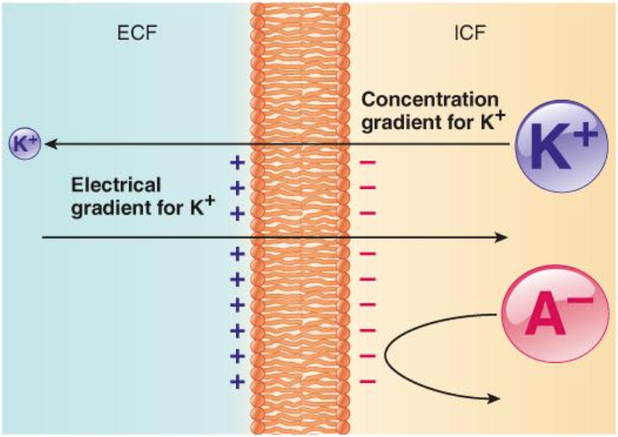
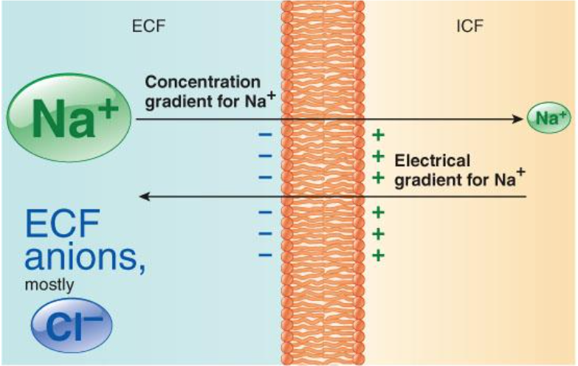
Electrochemical Equilibrium
Both Na⁺ and K⁺ move down their concentration gradients
There also exists an electrical gradient for both ions
Thus, movement of either ion will stop once there is a balance between chemical and electrical gradients… electrochemical equilibrium

Slide 7
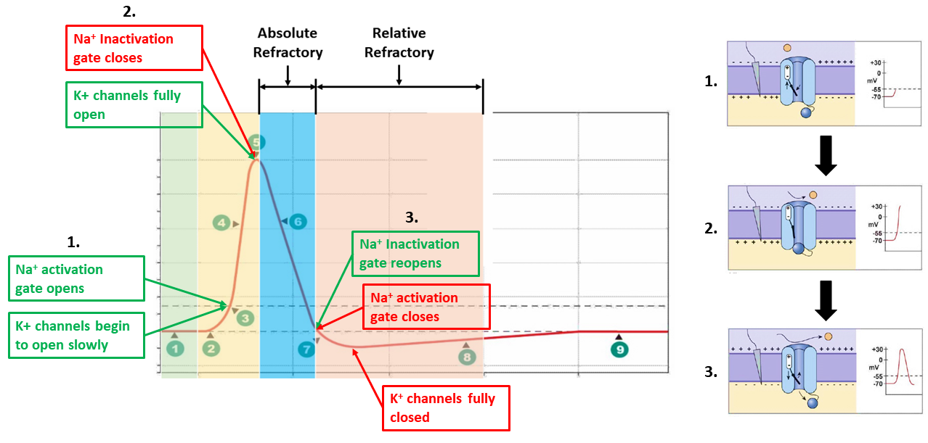
Activation & inactivation gates, and how to remember when they are open and closed.

Slide 8
Chapter 1
Dr. Woods

Slide 9
Chapter Overview
Homeostasis
Cell membrane and compartments
Diffusion and transport
Osmosis and tonicity
Action potential

Slide 10
Which of the following cells are excitable?
Neurons
Cardiac Muscle Cells
Smooth Muscle Cells
Skeletal Muscle Cells
If only 1, 2 and 3 are correct
If only 1 and 3 are correct
If only 2 and 4 are correct
If only 4 is correct
If ALL are correct

Slide 11
Which of the following cells are excitable?
Neurons
Cardiac Muscle Cells
Smooth Muscle Cells
Skeletal Muscle Cells
If only 1, 2 and 3 are correct
If only 1 and 3 are correct
If only 2 and 4 are correct
If only 4 is correct
If ALL are correct
Excitable Cells:
Generate and respond to electrical signals
Include neurons and muscle cells

Slide 12
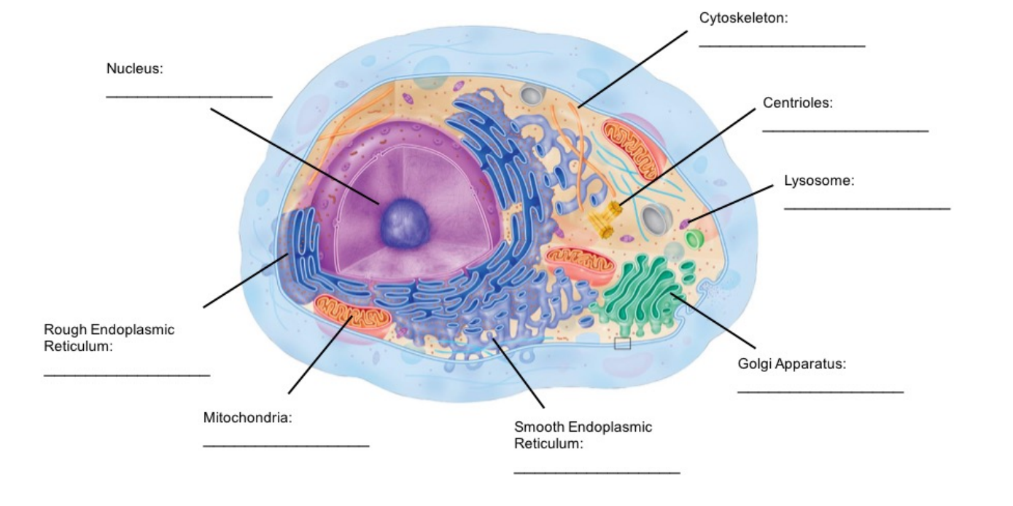
The Cell

Slide 13
Functions of organelles
Centrioles
Aid in cell division, in animals, by formation of spindle fibers that separate chromosomes during mitosis
Mitochondria
Supply the cell with energy in the form of ATP
Nucleus
Contains majority of cells genetic material
Plasma Membrane
Protect the cell from its surroundings
Composed of a phospholipid bilayer with embedded proteins
Lysosome
Houses enzymes for digestion and waste removal

Slide 14
Functions of organelles
Smooth Endoplasmic Reticulum
Manufacturing of lipid (fat) molecules
Rough Endoplasmic Reticulum
Rough due to ribosomes being dispersed throughout the membrane to help in the production, folding and transportation of proteins
Golgi Apparatus
Modify, sort and pack macromolecules (mostly proteins coming from the Rough ER)
Cytoskeleton
Composed filaments and tubules, extending from plasma membrane to nucleus
Provides the cell shape and protects it from damage

Slide 15
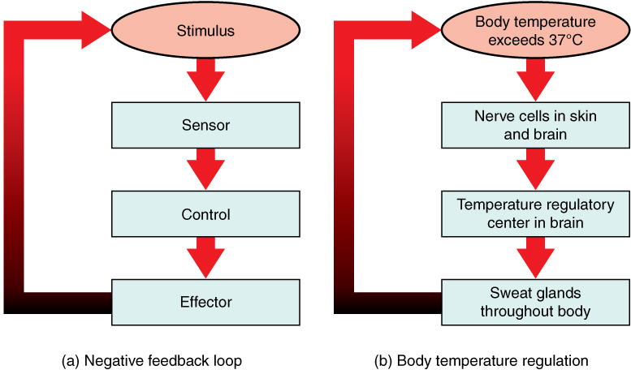
Negative feedback loops
Monitor and respond to changes in the internal environment in order to maintain homeostasis

Slide 16
Mechanisms of Membrane Transport
Endo/exocytosis
of small molecules
Diffusion through lipid bilayer
fat-soluble
Diffusion through protein channels
water soluble
Facilitated diffusion
large/bulky
Active transport
Against concentration gradient

Slide 17
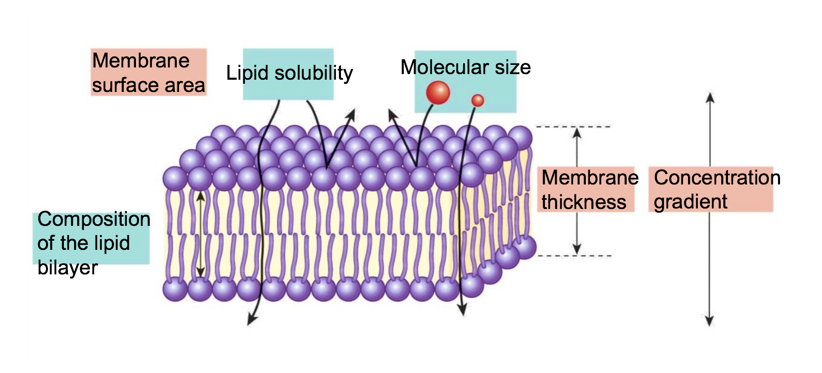
What affects rate of diffusion?
Concentration gradient
Composition of lipid bi-layer
Membrane thickness
Molecule size
Membrane surface area
Lipid solubility

Slide 18
Mechanisms of Membrane Transport
 | Simple Diffusion | Diffusion | Facilitated Transport | Active Transport
Selective? | No (still needs to be small & hydrophobic) | Yes | Yes | Yes
Competitive inhibition? | No | No | Yes | Yes
Goes with concentration gradient? | Yes | Yes | Yes | No
ATP required? | No | No | No | Yes

Slide 19
Which of the following statements are TRUE regarding osmosis?
The osmotic pressure of a solution is proportional to the concentration of the solute
A 100 mM NaCl solution has a greater osmolarity than a 100mM LiCl solution because Na is larger than Li
The permeability of the membrane affects osmosis
Osmosis is the movement of a solute down its concentration gradient
If only 1, 2 and 3 are correct
If only 1 and 3 are correct
If only 2 and 4 are correct
If only 4 is correct
If ALL are correct

Slide 20
Which of the following statements are TRUE regarding osmosis?
The osmotic pressure of a solution is proportional to the concentration of the solute
A 100 mM NaCl solution has a greater osmolarity than a 100mM LiCl solution because Na is larger than Li
The permeability of the membrane affects osmosis
Osmosis is the movement of a solute down its concentration gradient
If only 1, 2 and 3 are correct
If only 1 and 3 are correct
If only 2 and 4 are correct
If only 4 is correct
If ALL are correct

Slide 21
Which of the following statements regarding the cell’s membrane potential is TRUE?
Only neurons have a membrane potential
When an electrochemical equilibrium is reached (i.e. the electrical gradient force of an ion is equal in magnitude to its chemical gradient force), there is no movement of this ion across the membrane
The RMP is generated by the Na/K pump
It is affected by the concentration gradient of ions and the membrane permeability
If only 1, 2 and 3 are correct
If only 1 and 3 are correct
If only 2 and 4 are correct
If only 4 is correct
If ALL are correct

Slide 22
Which of the following statements regarding the cell’s membrane potential is TRUE?
Only neurons have a membrane potential
When an electrochemical equilibrium is reached (i.e. the electrical gradient force of an ion is equal in magnitude to its chemical gradient force), there is no movement of this ion across the membrane
The RMP is generated by the Na/K pump
It is affected by the concentration gradient of ions and the membrane permeability
If only 1, 2 and 3 are correct
If only 1 and 3 are correct
If only 2 and 4 are correct
If only 4 is correct
If ALL are correct

Slide 23
Osmosis
Osmosis is the net movement of WATER down its concentration gradient
It is affected by:
permeability of the membrane
concentration gradient of solutes
pressure gradient across the cell membrane
Osmolarity is concerned only with the NUMBER OF PARTICLES in solution (NOT size or type/composition)

Slide 24
Which of the following solutions would cause a red blood cell to swell?
200mM NaCl
300mM NaCl
150 mM KCl
100 mM KCl

Slide 25
Which of the following solutions would cause a red blood cell to swell?
200mM NaCl
300mM NaCl
150 mM KCl
100 mM KCl

Slide 26
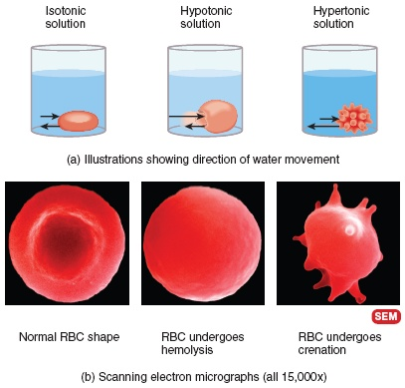
Tonicity
Less solute
More solute

Slide 27
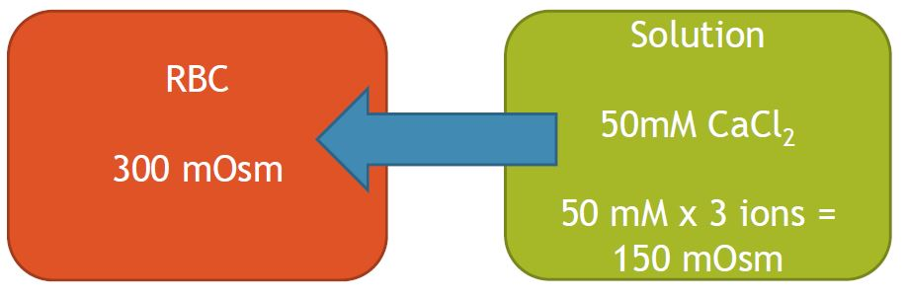
Tonicity Example
A red blood cell is placed in a 50 mM CaCl2 solution. The cell will __________ because the solution is _____________
Water moves from the solution into the RBC

Slide 28
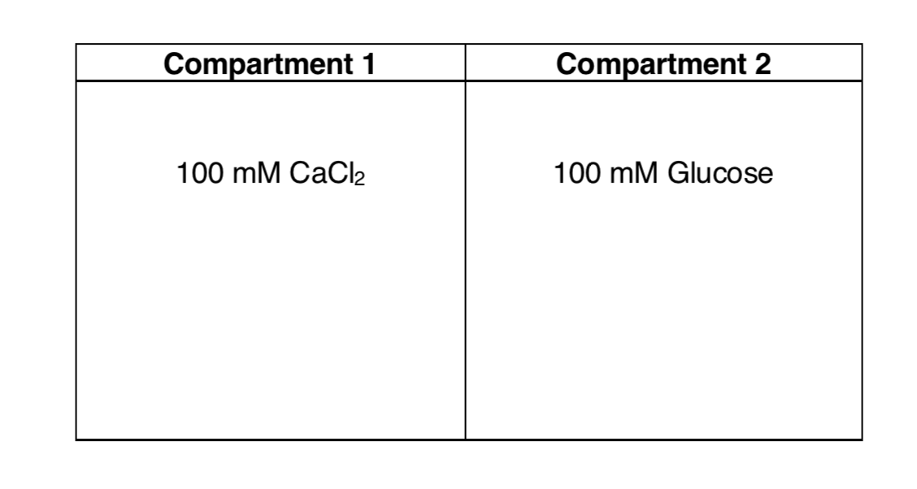
Tonicity Example
Only permeable to water
Water moves from compartment A to B
300mM of Glucose
175mM of NaCl

Slide 29
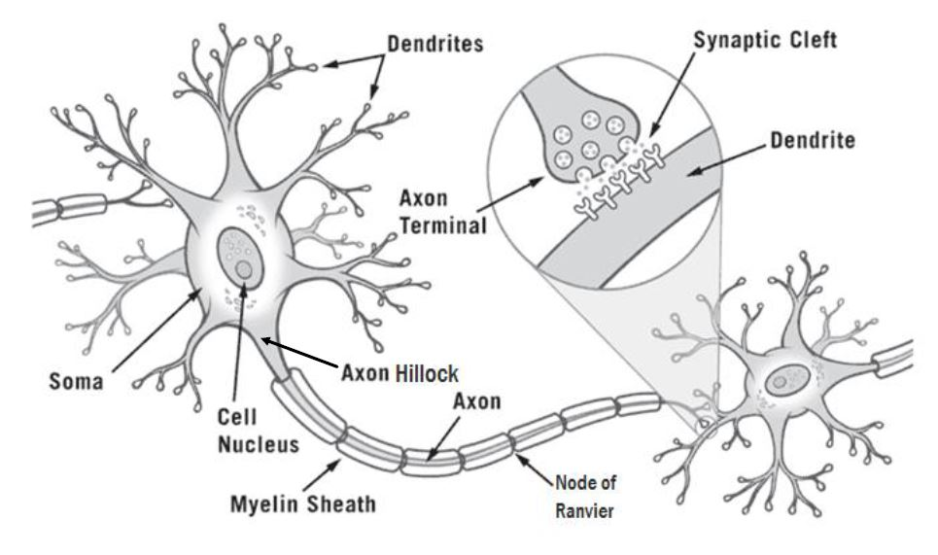
The Neuron

Slide 30
Key Events and Their Locations
Incoming information received by the dendrites
Graded potentials occur in the dendrites/soma
An action potential is fired at the axon hillock if threshold is met
The action potential travels along the myelinated axon via salutatory conduction
The action potential arrives at the axon terminal of the pre-synaptic cell and the message is passed to the post-synaptic cell

Slide 31
What is a main difference between a graded potential and an action potential?
Graded potentials do not experience current leak, whereas action potentials do
Graded potentials travel a long distance, whereas action potentials travel a short distance
Graded potentials occur at the soma, whereas action potentials start at the axon hillock
The amplitude of the graded potentials is not proportional to the stimulus strength, whereas the amplitude of action potentials is proportional to the stimulus strength

Slide 32
What is a main difference between a graded potential and an action potential?
Graded potentials do not experience current leak, whereas action potentials do
Graded potentials travel a long distance, whereas action potentials travel a short distance
Graded potentials occur at the soma, whereas action potentials start at the axon hillock
The amplitude of the graded potentials is not proportional to the stimulus strength, whereas the amplitude of action potentials is proportional to the stimulus strength

Slide 33
Graded Potentials vs. Action Potentials
Graded Potentials | Action Potentials
Occur at dendrites/somas | Occur at axon hillock
Caused by mechanical or chemical-gated channels | Caused by voltage-gated channels
Can be a depolarization or hyperpolarization | Always a depolarization
Amplitude of potential is directly proportional to stimulus strength | All or nothing–Amplitude of potential is constant no matter the stimulus strength
Travel short distances | Travel long distances

Slide 34
Which of the following structures are correctly associated with their function?
Dendrites send outgoing signals
Myelin insulates axons to prevent ion/current leak
There are no ion channels at the Nodes of Ranvier
There are no organelles at the soma

Slide 35
Which of the following structures are correctly associated with their function?
Dendrites send outgoing signals
Myelin insulates axons to prevent ion/current leak
There are no ion channels at the Nodes of Ranvier
There are no organelles at the soma

Slide 36
How can we increase the propagation speed of an action potential down an axon?
Increase diameter of the axon
Decrease diameter of the axon
Myelinate the axon
A and C

Slide 37
How can we increase the propagation speed of an action potential down an axon?
Increase diameter of the axon
Decrease diameter of the axon
Myelinate the axon
A and C

Slide 38
Depolarization is caused by the opening of ____, causing ___ to flow ___ the cell.
VG Na⁺ channels; Na⁺ ions; into
VG Na⁺ channels; Na⁺ ions; out of
VG K⁺ channels; K⁺ ions, into
VG K⁺ channels; K⁺ ions, out of

Slide 39
Depolarization is caused by the opening of ____, causing ___ to flow ___ the cell.
VG Na⁺ channels; Na⁺ ions; into
VG Na⁺ channels; Na⁺ ions; out of
VG K⁺ channels; K⁺ ions, into
VG K⁺ channels; K⁺ ions, out of

Slide 40
The Na⁺ and K⁺ voltage-gated channels are important in action potential conduction. Which of the following statements is/are true regarding the state of these channels during the repolarization phase?
the Na⁺ activation gate will be open
Na⁺ will be leaving the cell
the K⁺ voltage-gated channel will be open
the K⁺ activation gate will be open
if only 1,2 and 3 are correct
if only 1 and 3 are correct
if only 2 and 4 are correct
if only 4 is correct
if ALL are correct

Slide 41
The Na⁺ and K⁺ voltage-gated channels are important in action potential conduction. Which of the following statements is/are true regarding the state of these channels during the repolarization phase?
the Na⁺ activation gate will be open
Na⁺ will be leaving the cell
the K⁺ voltage-gated channel will be open
the K⁺ activation gate will be open
if only 1,2 and 3 are correct
if only 1 and 3 are correct
if only 2 and 4 are correct
if only 4 is correct
if ALL are correct

Slide 42
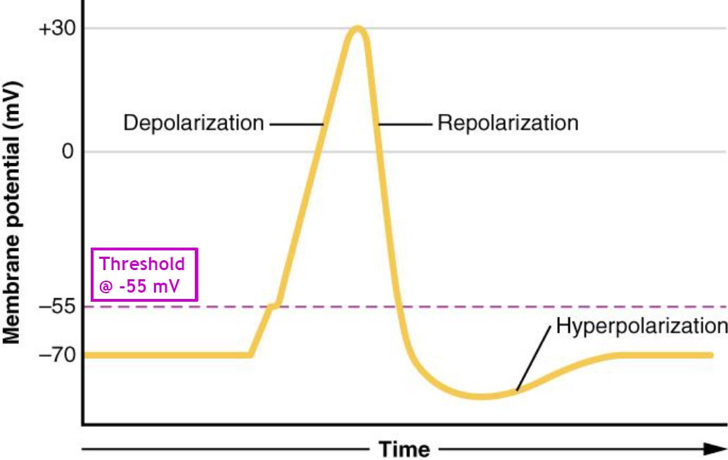
The Action Potential
Depolarization
Potential becomes more +ve
VG Na⁺ C open (fast)
Na⁺ flows into cell
VG K⁺ C start to open (slow)
Repolarization
Potential returns to RMP
VG Na⁺ C inactive
VG K⁺ C fully open
K⁺ flows out of cell
Absolute Refractory Period
Hyperpolarization
Potential becomes more –ve than RMP
VG Na⁺ C close
VG K⁺ C start to close (slow)
RMP
VG Na⁺ C close
VG K⁺ C fully closed

Slide 43
Which of the following events take place at a chemical synapse?
VG Ca²⁺ channels open, allowing Ca²⁺ to flow out of the cell
VG Ca²⁺ channels open, allowing Ca²⁺ to flow into the cell
Neurotransmitters travel from the post-synaptic cell to the pre-synaptic cell
Neurotransmitters travel from the pre-synaptic cell to the post-synaptic cell
If only 1, 2 and 3 are correct
If only 1 and 3 are correct
If only 2 and 4 are correct
If only 4 is correct
If ALL are correct

Slide 44
Which of the following events take place at a chemical synapse?
VG Ca²⁺ channels open, allowing Ca²⁺ to flow out of the cell
VG Ca²⁺ channels open, allowing Ca²⁺ to flow into the cell
Neurotransmitters travel from the post-synaptic cell to the pre-synaptic cell
Neurotransmitters travel from the pre-synaptic cell to the post-synaptic cell
If only 1, 2 and 3 are correct
If only 1 and 3 are correct
If only 2 and 4 are correct
If only 4 is correct
If ALL are correct

Slide 45
Synapse
What happens to extra neurotransmitters?
Recycled into axon terminal
Degraded by enzymes
Diffuse out of cleft
What happens to the post-synaptic cell?
If Na+ channels open: EPSP
Na⁺ into cell
Depolarization of post-synaptic cell (graded potential towards threshold)
If K⁺ or Cl⁻ channels open: IPSP
K⁺ out of cell or Cl⁻ into cell
Hyperpolarization of post-synaptic cell (graded potential away from threshold)

Slide 46
Chapter 2
Dr. Everling

Slide 47
Chapter Overview
Nervous system overview
Touch
Vision
Audition

Slide 48
Divisions of the Nervous System
Fight or flight
Rest and digest

Slide 49
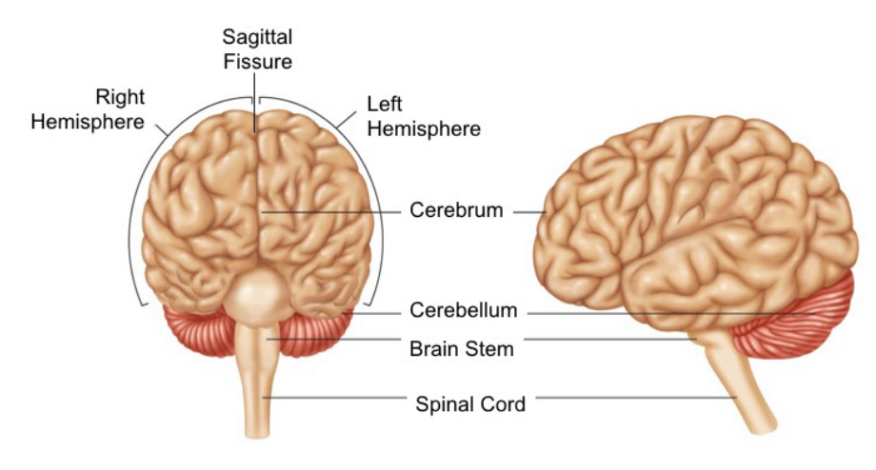
CNS Major Parts and Functions

Slide 50
White vs. Grey Matter
 | White Matter | Grey Matter
Colour | White | Grey
Components | Axons | Cell bodies, dendrites and axon terminals
Myelin present | Yes, gives white appearance | No
Function | For communication between grey matter sites | Processing of information

Slide 51
Which of the following is true regarding the spinal cord?
The C1 spinal cord segment receives sensory input from all cervical dermatomes
The C1 spinal cord segment receives sensory input from the head and face
Lesion of the spinal cord at C8 will affect sensory input from all thoracic dermatomes
Lesion of the spinal cord at L1 will affect sensory input from all thoracic dermatomes

Slide 52
Which of the following is true regarding the spinal cord?
The C1 spinal cord segment receives sensory input from all cervical dermatomes
The C1 spinal cord segment receives sensory input from the head and face
Lesion of the spinal cord at C8 will affect sensory input from all thoracic dermatomes
Lesion of the spinal cord at L1 will affect sensory input from all thoracic dermatomes

Slide 53
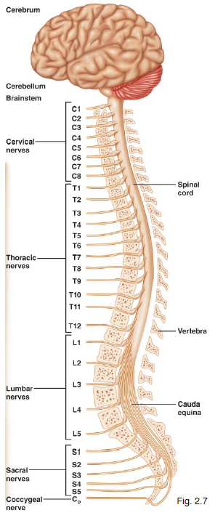
CNS: The Spinal Cord
White and gray matter are opposite to the brain (spinal cord: white external and grey internal)
31 segments
Each segment has a pair of spinal nerves (PNS) – 31 pairs of spinal nerves
Each segment receives sensory info and sends motor info to a similar region
On the skin, the sensory region is called a dermatome

Slide 54
PNS: Spinal Nerves
Sensory information is carried TOWARDS (afferent neuron) the spinal cord through the dorsal root
Motor information is carried OUT (efferent) the spinal cord through the ventral root
“SAME DAVE” sensory afferent motor efferent dorsal afferent ventral efferent

Slide 55
Which of the following relationships are true regarding mechanoreceptors?
Receptors superficial in the skin have small receptive fields
Receptors deep in the skin have low tactile acuity
Receptors with small receptive fields have high tactile acuity
Receptors with large receptive fields have high tactile acuity
If only 1, 2 and 3 are correct
If only 1 and 3 are correct
If only 2 and 4 are correct
If only 4 is correct
If ALL are correct

Slide 56
Which of the following relationships are true regarding mechanoreceptors?
Receptors superficial in the skin have small receptive fields
Receptors deep in the skin have low tactile acuity
Receptors with small receptive fields have high tactile acuity
Receptors with large receptive fields have high tactile acuity
If only 1, 2 and 3 are correct
If only 1 and 3 are correct
If only 2 and 4 are correct
If only 4 is correct
If ALL are correct

Slide 57
Skin Mechanoreceptors
Receptor | Location | Adaption Rate | Receptive Field Size
Merkel’s Disks | Epidermis-Dermis Border | Slow | Small
Meissner’s corpuscles | Dermis (Surface) | Rapid | Small
Ruffini’s endings | Dermis (Deep) | Slow | Large
Pacinian corpuscles | Dermis (Deep) | Rapid | Large

Slide 58
Which lobe receives incoming somatosensory information?
Located on postcentral gyrus (posterior to central sulcus; parietal lobe)
Somatotopy: body regions correspond to specific points on the brain
Magnification factor: particular body regions are overrepresented
There is plasticity in the somatosensory system (i.e. cortical maps can change)

Slide 59
Components of the Visual system
Fundamental Components:
Eye → Retina → Optic Nerve → Optic Chiasm → Optic Tract →LGN → Optic radiations →Primary Visual Cortex
Retinal Targets:
Lateral geniculate nucleus (LGN)
Main target (90% of info)

Slide 60
Which lesions of the visual pathway would result in a loss of visual perception in the contralateral visual field?
Lesion of the optic nerve
Lesion of the optic tract
Lesion of the optic chiasm
Lesion of the optic radiation

Slide 61
Which lesions of the visual pathway would result in a loss of visual perception in the contralateral visual field?
Lesion of the optic nerve
Lesion of the optic tract
Lesion of the optic chiasm
Lesion of the optic radiation

Slide 62
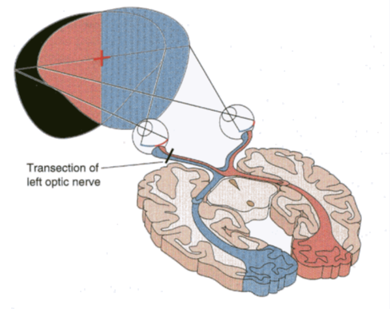
Visual Pathway: Lesion at Optic Nerve
Left optic nerve lesion
See only visual field of right eye (same as closing left eye)
Right optic nerve lesion
See only visual field of left eye (same as closing right eye)

Slide 63
Visual Pathway: Lesion at Optic Chiasm
Lesion at optic chiasm
Tunnel Vision (i.e. lose nasal retina axons, which carried info from peripheral vision)

Slide 64
Visual Pathway: Lesion at Optic Tract
Left optic tract lesion
See only left hemifield (i.e. lose right hemifield)
Right optic tract lesion
See only right hemifield (i.e. lose left hemifield)

Slide 65
Eye (Gross Anatomy)
Pathway of light:
Cornea →Anterior Chamber (with aqueous humor) →Pupil →Lens →Posterior Chamber (with vitreous humor) →Retina
Other important Structures:
Iris
Sclera
Conjuctiva
Extraocular Eye Muscles
Ciliary Muscles
Fovea
Optic disk (Blindspot)

Slide 66
Functions of Gross Eye Anatomy
Pupil: Black space in center of eye
Iris: Color part, regulates size of pupil
Lens: Changes shape in response to distance of object
Cornea: Protects the eye, found anterior to lens and pupil
Sclera: Contains collagen fibers, protective layer around eye
Conjunctiva: Thin film between eye and eyelid
Optic Nerve: Where axons converge and leave eye

Slide 67
Functions of Gross Eye Anatomy
Extraocular eye muscles: Move eye around in orbit
Ciliary Muscles: Intraocular muscles that pull on lens to change it’s shape.
Aqueous Humor: Fluid within the anterior chamber.
Vitreous Humor: Clear/thick fluid within the posterior chamber.
Retina: Consists of pigmented layer and several neuronal layers that are involved in phototransduction
Fovea: Center of retina, provides accurate vision in the direction that it is pointed (contains only cones).

Slide 68
Functions of Gross Eye Anatomy
Photoreceptors: Phototransduction, light is converted to chemical energy.
Rods: Light sensitive, white/black, function well in low light
Cones: Color sensitive, red/green/blue
Bipolar cells: First cell after action potential is generated in photoreceptors.
Ganglion cells: The output neurons, axons form the optic nerve
Horizontal cells: Side-to-side modulation
Amacrine cells: Side-to-side modulation, inhibitory neurons
Pigmented Epithelium: Absorbed excess light

Slide 69
Eye (Gross Anatomy)
Optic disk
(blind spot)
Fovea
Temporal Retina
Nasal Retina
Nasal Retina
Temporal Retina
Right Eye
Macula
Left Eye

Slide 70
The cell bodies of bipolar cells can be found in which layer of the retina?
Inner plexiform layer
Inner nuclear layer
Outer plexiform layer
Outer nuclear layer

Slide 71
The cell bodies of bipolar cells can be found in which layer of the retina?
Inner plexiform layer
Inner nuclear layer
Outer plexiform layer
Outer nuclear layer

Slide 72
Retinal Cells
Main Pathway:
Photoreceptors (rods and cones)
Bipolar cells
Ganglion cells
Modulation and Communication:
Horizontal cells
Amacrine cells

Slide 73
Which of the following relationships are true regarding the retina?
Rods and cones are distributed evenly within the retina
The fovea contains both rods and cones
No photoreceptors are found within the optic disk
The fovea forms a pit, pushing bipolar and ganglion cells aside
If only 1, 2 and 3 are correct
If only 1 and 3 are correct
If only 3 and 4 are correct
If only 4 is correct
If ALL are correct

Slide 74
Which of the following relationships are true regarding the retina?
Rods and cones are distributed evenly within the retina
The fovea contains both rods and cones
No photoreceptors are found within the optic disk
The fovea forms a pit, pushing bipolar and ganglion cells aside
If only 1, 2 and 3 are correct
If only 1 and 3 are correct
If only 3 and 4 are correct
If only 4 is correct
If ALL are correct

Slide 75
Two Photoreceptors: Rods vs. Cones
Feature | Rods | Cones
Sensitive to… | White/Black | Color
Lighting conditions… | Dim light | Daylight
Located | Around retina | Only in fovea
Amount | Many (120 million/retina) | Few (5 million/retina)

Slide 76
Sensory: Auditory System
Chapter 2: Dr. Everling

Slide 77
Divisions of Auditory System
Outer Ear: AIR
Auricle (Pinna)
Auditory Canal: enhances intensity by resonance (reflection of sound waves in closed tube enhances intensity of certain frequencies)
Middle Ear: AIR
Tympanic Membrane (Eardrum): transmits sound from air to ossicles
3 Ossicles: Malleus, Incus and Stapes: convert air pressure changes to mechanical pressure
Auditory (Eustachian) Tube: important in changing air pressure
Inner Ear: FLUID
Cochlea: convert fluid vibrations into electrochemical impulses carried to brain

Slide 78
Cochlea
Two windows
Oval Window: connected to stapes; transfers vibrations to perilymph fluid
Round Window: counterbalances movement of oval window

Slide 79
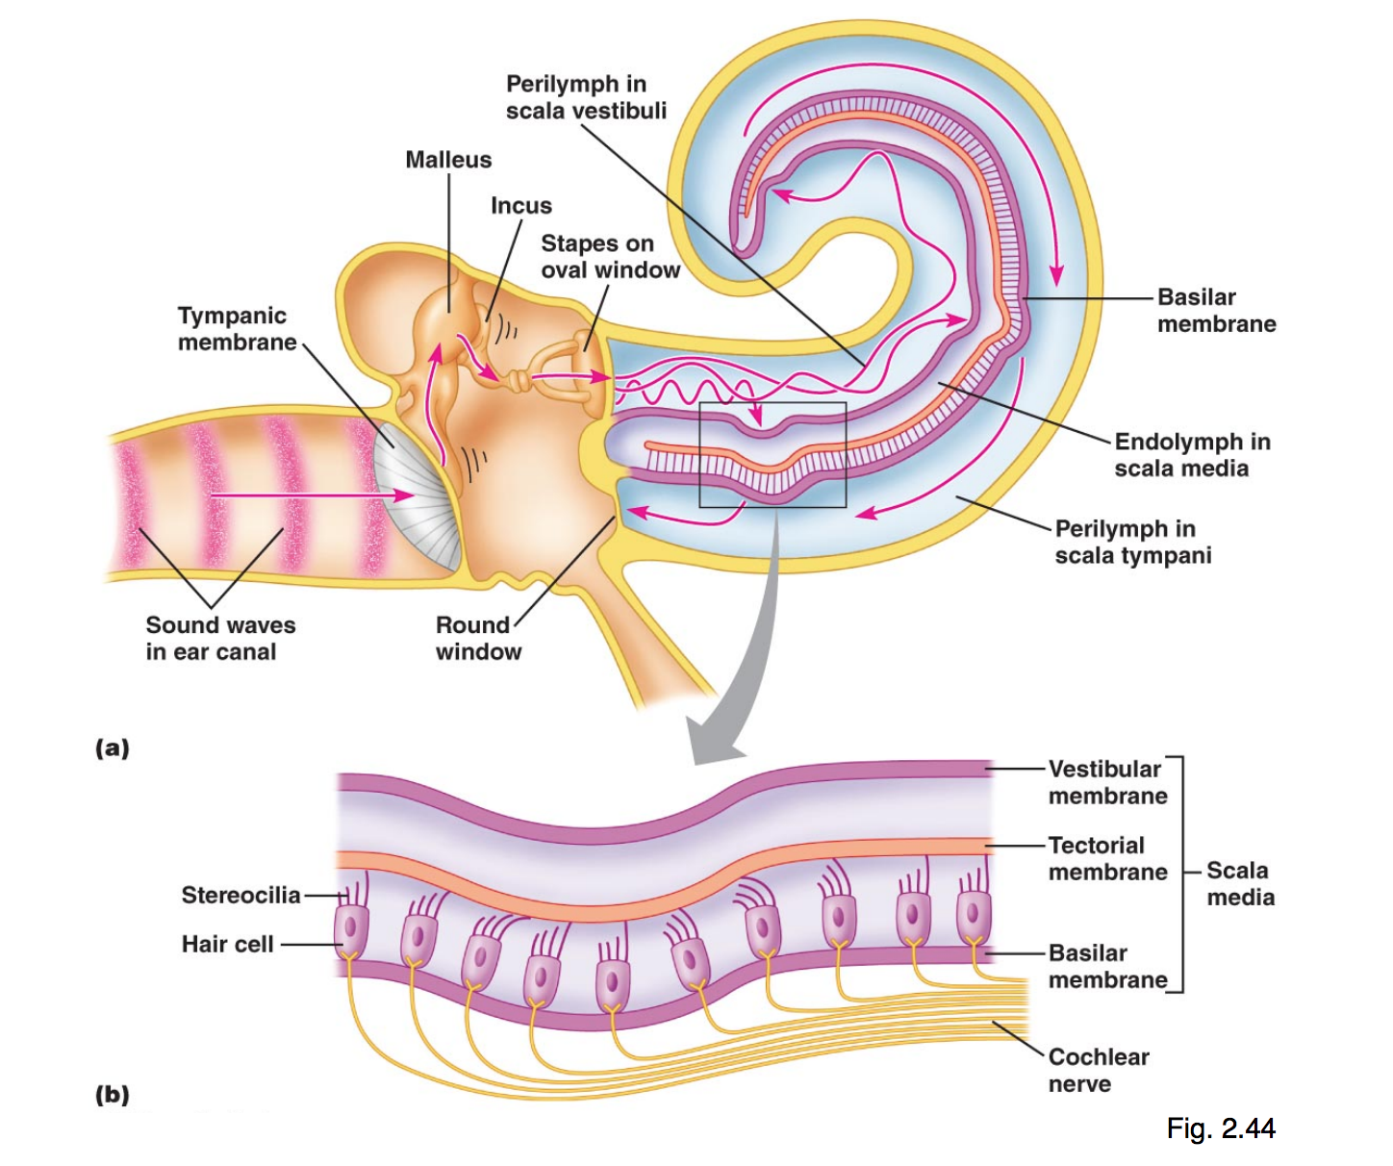
Cochlea

Slide 80
Divisions of Auditory System
Organ of Corti contains hair cells with stereocilia:
Fluid movements cause deflection of basilar membrane
Basilar membrane deflection leads to dragging of hair cells against the tectorial membrane
Stereocilia bend from dragging
Hair cells depolarize when stereocilia bend
Mechanically-linked ion channels open (depolarization)
Aka brings cell to threshold → AP is fired
When hair cells bend in other direction the cell is hyperpolarized

Slide 81
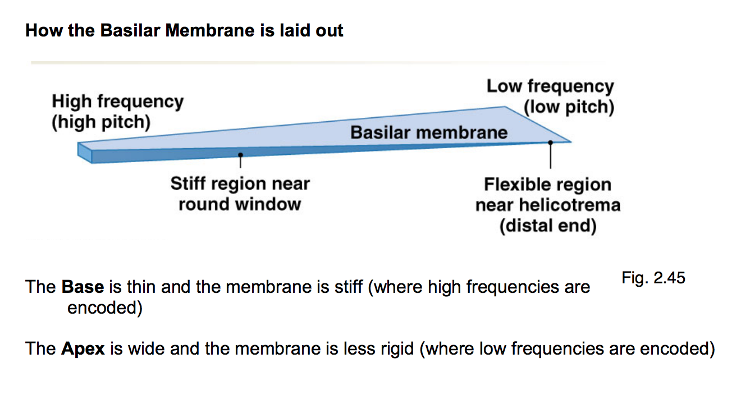
Basilar Membrane
Gradient:
Base: narrow and stiff; detects high frequency
Apex: wide and floppy; detects low frequency

Slide 82
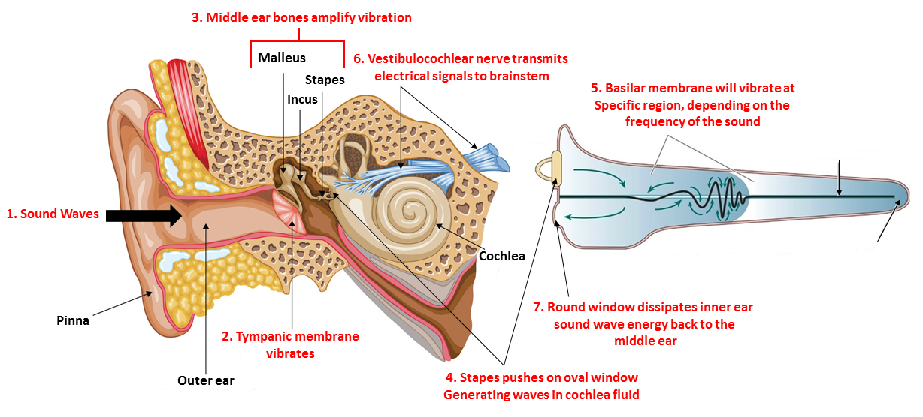
How Sound Travels Through Ear

Slide 83
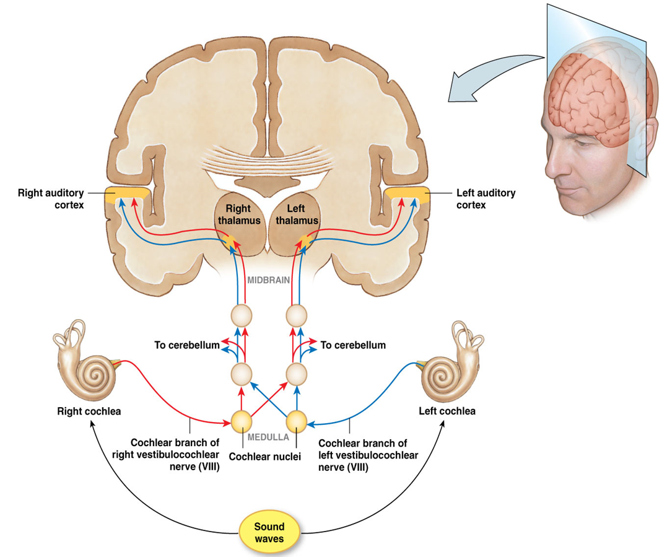
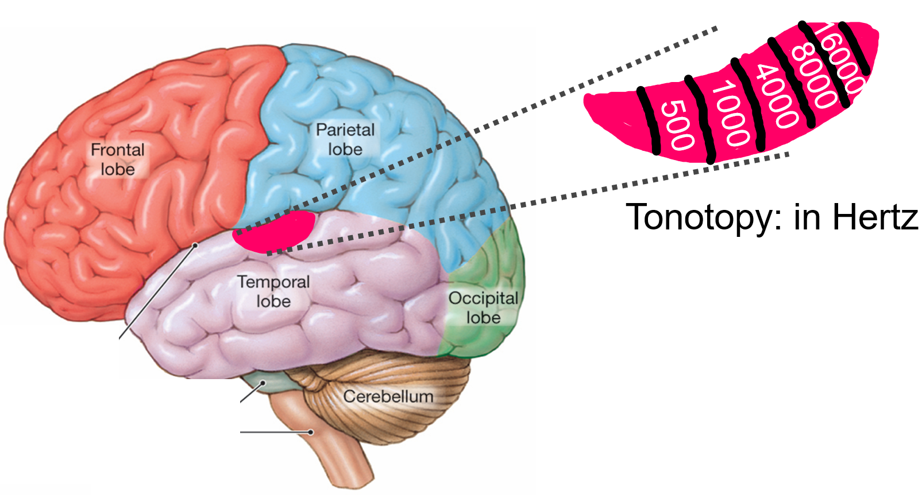
Auditory Pathway
Auditory Nerve (Vestibulocochlear nerve)
Formed by axons of spiral ganglion cells
Medulla
Info from right and left ears combine
Midbrain
Projections to cerebellum
Primary Auditory Cortex (Temporal Lobe)
Tonotonic Map:
Anterior: Low frequencies
Posterior: High frequencies

Slide 84
Neurons in all the following structures receive input from both ears except:
Inferior colliculus
Cochlear nucleus
Medial geniculate nucleus
Superior Olive

Slide 85
Neurons in all the following structures receive input from both ears except:
Inferior colliculus
Cochlear nucleus
Medial geniculate nucleus
Superior Olive

Slide 86
Hearing Loss
Conductive: Sound is unable to be transmitted through outer or middle ear.
A mechanical defect
e.g. Extremely loud sounds rupture eardrum or damaged ossicles
Sensorineural: damage to structures of inner ear that affects hair cells, or to auditory nerve (nerve deafness)
e.g. Extremely loud sounds damage Organ of Corti
e.g. Presbycusis (old + hearing), i.e. degenerations in the cochlea
Central: Damage to auditory pathways upstream from cochlea
A defect in the Central Nervous system
e.g. tumours or strokes in the central auditory pathways

Slide 87
Motor Physiology
Chapter 3: Dr. Everling

Slide 88
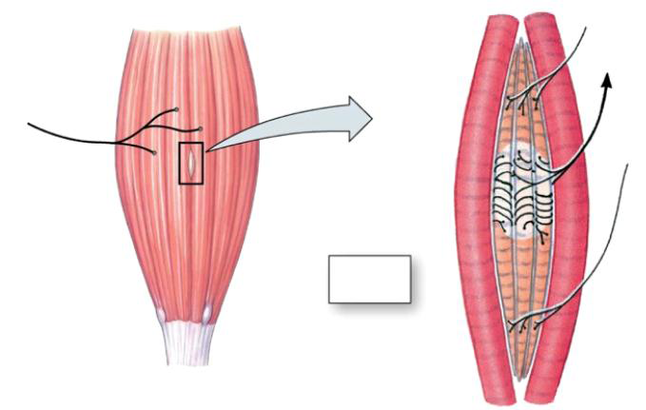
Muscle Anatomy
Gamma Motor Units
Extrafusal Muscle Fibres
1a afferent neuron
Alpha Motor Unit
Golgi Tendon Organ
Intrafusal muscle
Muscle Spindle
Tendon

Slide 89
Muscle Spindle
Stretching of muscle spindle/intrafusal muscle fiber
Info sent from muscle spindles to CNS via 1a afferent neurons
CNS processes info
Alpha motor neuron causes extrafusal muscle fiber contraction
Gamma motor neuron causes intrafusal fiber contraction

Slide 90
Golgi Tendon Organ
Golgi tendon organ links muscle and tendon
Collagen fibers woven around sensory receptors
Increase in tension causes collagen contraction around sensory receptor, which sends info to CNS via 1b afferent neuron

Slide 91
Reflexes
Reflex: involuntary response to a stimulus which requires the integrity of the nervous system
Reflex arc involves: Receptor →Afferent neuron →Synapse →Motor neuron → Effector
Monosynaptic reflex: Pathway in a reflex arc that contains only 1 synapse (ex: stretch reflex)
Polysynaptic reflex: Pathway in a reflex arc that contains more than 1 synapse (ex: withdrawal reflex)
Reciprocal Innervation: Contraction of a muscle is accompanied by simultaneous inhibition of antagonistic muscle

Slide 92
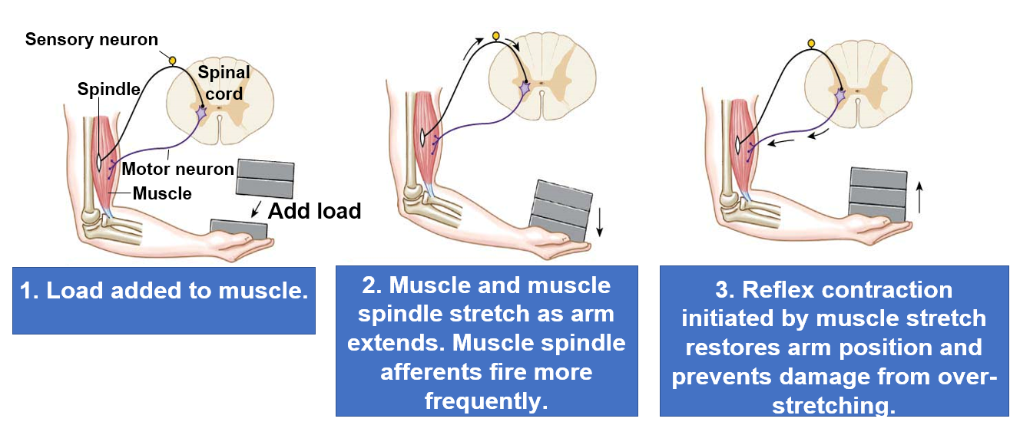
Stretch Reflex

Slide 93
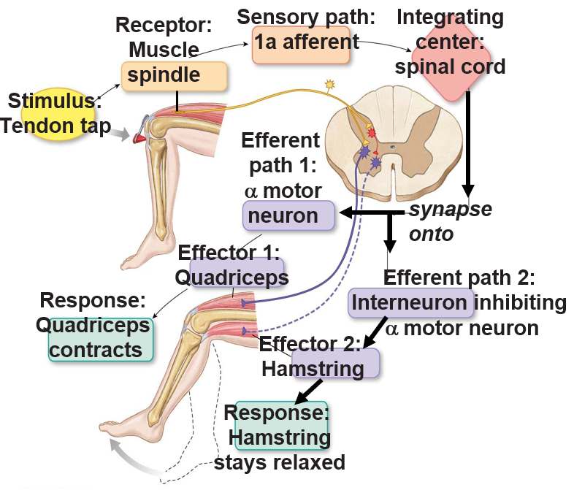
Patellar Tendon Reflex
Tapping patellar tendon stretches quadriceps femoris (extensor muscle)
Muscle spindle in quadriceps femoris stretches, activating 1a afferent to fire action potentials.
1a afferent directly synapses (monosynaptic) on alpha motor neuron to quadriceps femoris – muscle contracts and lower leg swings forward.
Collateral from the 1a afferent also excites an inhibitory interneuron in the spinal cord.
Inhibitory interneuron inhibits alpha motor neuron to antagonistic (Hamstring) muscle. The hamstring is a flexor muscle.
Antagonistic muscle relaxes (reciprocal innervation (inhibition) so leg can extend and swing out.

Slide 94
Motor Physiology: The Cerebellum and Basal Ganglia
Chapter 3: Dr. Everling

Slide 95
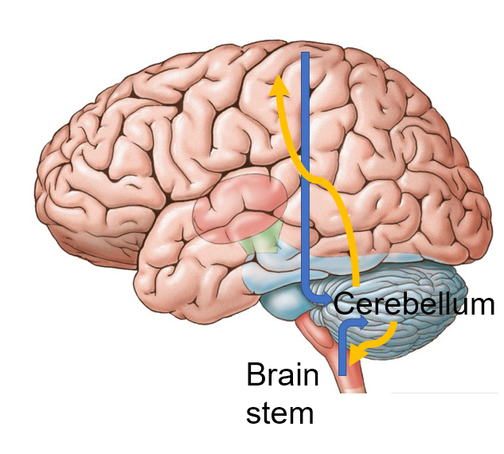
The Cerebellum
Function: evaluates difference between intended and actual movement action
Cortex, brain stem and spinal cord send signals TOWARDS
Cerebellum sends signals BACK, however these can be modified for motor learning

Slide 96
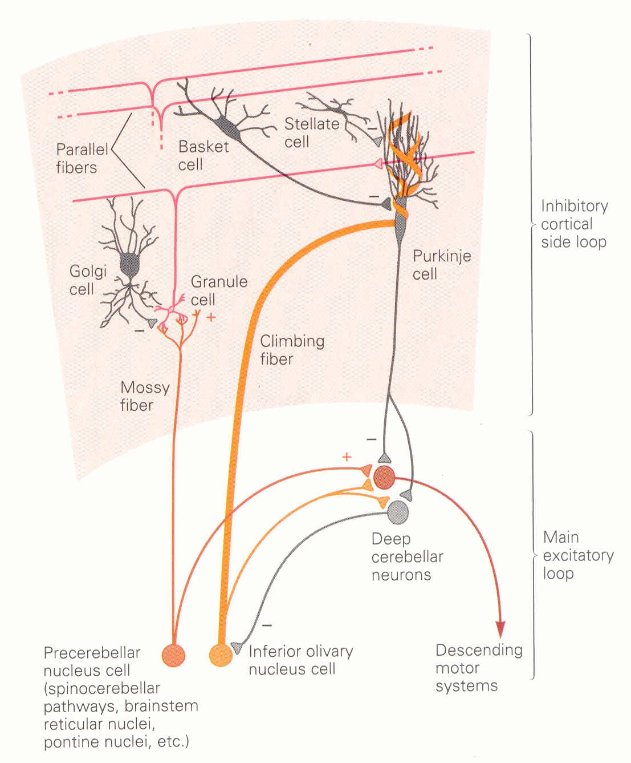
The Cerebellum Circuit
Two inputs:
Mossy fibers: Synapse on granule cells.
Axons of granule cells form parallel fibers which synapse on Purkinje cells
Climbing fibers: Synapse directly on Purkinje cells.
Mossy and climbing fibers excite Purkinjie cells, which provide cerebellum output through inhibition

Slide 97
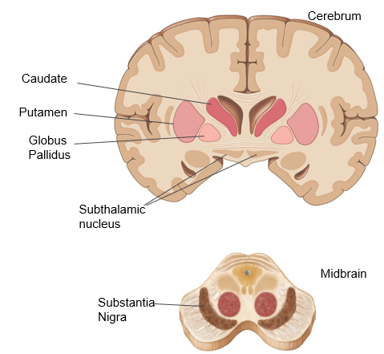
The Basal Ganglia
Function: regulating and planning movements
Cortex send signals TOWARDS
Basal ganglia sends signals BACK through the thalamus
Two main functions
Production of movement – direct pathway
Inhibition of movement – indirect pathway

Slide 98
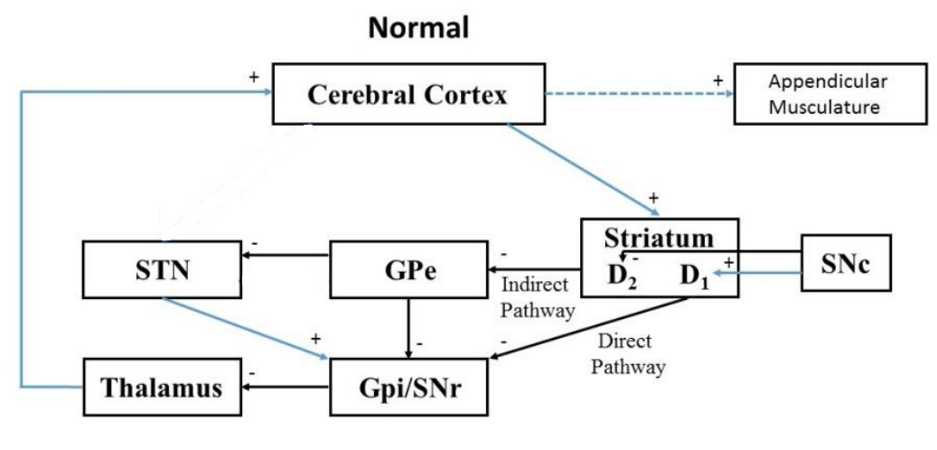
Basal Ganglia Circuit
Cerebral cortex sends excitatory signals to striatum (caudate + putamen)
Direct pathway (movement):
striatum inhibitory projections to globus pallidus internal
globus pallidus inhibitory projections to thalamus
Indirect pathway (Inhibit movement):
striatum inhibitory projections to globus pallidus external
globus pallidus external inhibitory projections to subthalamic nucleus
subthalmic nucleus excitatory projections to globus pallidus internal
globus pallidus internal inhibitory projections to thalamus
thalamus excitatory projections to cortex

Slide 99
Less Dopamine
Less dopamine from substantia nigra pars compacta
Direct pathway DE-ACTIVATED:
striatum will not inhibit the globus pallidus internal
Indirect pathway ACTIVATED:
striatum will inhibit globus pallidus external
globus pallidus external will no longer inhibit the subthalamic nucleus
subthalmic nucleus will cause excitation of globus pallidus internal
globus pallidus internal inhibits the thalamus
thalamus will no longer excite the cortex
Movement inhibited
Less dopamine
excitatory
inhibitory

Slide 100
More Dopamine
More dopamine from substantia nigra pars compacta
Direct pathway ACTIVATED:
striatum will inhibit the globus pallidus internal
globus pallidus internal will no longer inhibit the thalamus
Indirect pathway DE-ACTIVATED:
striatum will no longer inhibit the globus pallidus external
globus pallidus external will inhibit the subthalamic nucleus
subthalmic nucleus will no longer excite the globus pallidus internal
globus pallidus internal no longer inhibits the thalamus
thalamus will excite the cortex
Movement initiated
More dopamine
excitatory
inhibitory

Slide 101
Parkinson Disease
Loss of neurons in substantia nigra pars compacta
Direct pathway DE-ACTIVATED:
striatum will not inhibit the globus pallidus internal
Indirect pathway ACTIVATED:
striatum will inhibit globus pallidus external
globus pallidus external will no longer inhibit the subthalamic nucleus
subthalmic nucleus will cause excitation of globus pallidus internal
globus pallidus internal inhibits the thalamus
thalamus will no longer excite the cortex
Movement inhibited
Less dopamine
excitatory
inhibitory

Slide 102
Endocrinology: Introduction
Chapter 3: Dr. Beye

Slide 103
Which of the following best describes endocrine/hormonal signaling?
A cell sending a signal to itself
A cell sending a signal to its neighbor
A neuron sending a neurotransmitter to another neuron
A cell sending a signal to a distance organ

Slide 104
Which of the following best describes endocrine/hormonal signaling?
A cell sending a signal to itself
A cell sending a signal to its neighbor
A neuron sending a neurotransmitter to another neuron
A cell sending a signal to a distance organ

Slide 105
Endocrinology
Communication mechanism for organ systems and cells
Utilizes hormones for cellular signaling to distant sites throughout the body
Parameter | Nervous System | Endocrine System
Type of signal? | Neurotransmitters | Hormones
Where do signals travel | Synapse | Blood
Communication Speed | Rapid | Slow

Slide 106
Types of Hormones
Hormone: A chemical signal secreted into the bloodstream to act on a distant tissue
The target cells of the hormone need the receptor
Parameter | Peptide/Protein | Steroid | Amine
 |  |  | Hydrophilic | Hydrophobic
Examples | Hormones that end in “-in” | Hormones that end in “-ol” or “-one” | Epinephrine | Thyroid Hormones
Precursor | Amino acids | Cholesterol | Tyrosine | Tyrosine
Solubility | Hydrophilic | Lipophilic | Hydrophilic | Hydrophobic
Blood transport | Dissolves | Bound to protein | Dissolves | Carrier protein
Receptor location | Cell surface | Intracellular | Extracellular | Intracellular
Speed of action | Fast | Slow | Fast | Slow
Goal | Alter existing proteins | Produce new proteins | Alter proteins | Produce new proteins

Slide 107
Endocrine: Anterior pituitary and thyroid
Chapter 3: Dr. Beye

Slide 108
Hypothalamus-Anterior Pituitary
GnRH
Gonadotropin releasing hormone
FSH and LH
Gonads
CRH
Corticotropin releasing hormone
ACTH
Adrenal glands
TRH
Thyrotropin releasing hormone
TSH
Thyroid
Dopamine
(Inhibitory)
Prolactin
Mammary glands
GHRH
Growth hormone releasing hormone
GH
Bone, liver, skeletal muscle and fat
Hypothalamus
Anterior
pituitary
Target
Hypothalamus makes and releases hormone into portal system
Hormone travels through hypothalamic hypophyseal portal system to ant pit
Hormone acts on ant pit to make and release a hormone into general circulation
Hormone travels through general circulation to target tissue

Slide 109
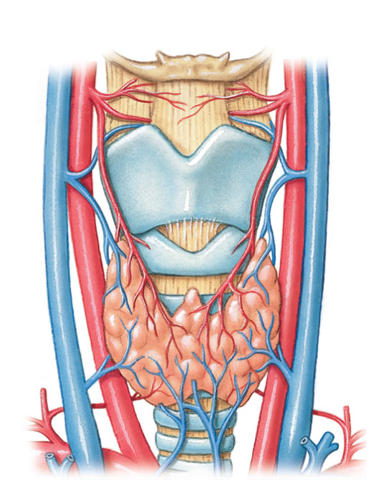
Thyroid Gland
Thyroid Cartilage
Thyroid Gland
Trachea

Slide 110
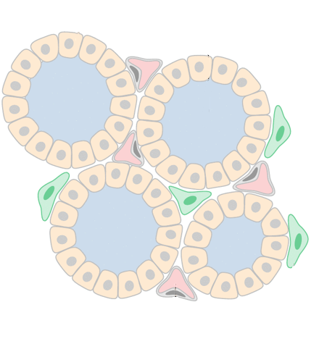
Thyroid Gland
Follicular cell
Colloid
Capillary: TH transport
Follicle: functional unit where TH is made
Colloid: TH is made and stored here
Follicular cells: acquire and produce TH building blocks
Follicle
Capillary

Slide 111
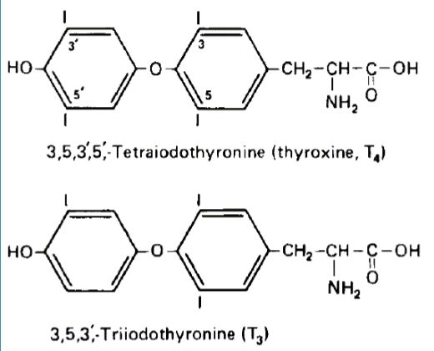
Thyroid Hormone Overview
TH is an amine hormone with properties similar to steroid hormone
Function: increase basal metabolic rate; acts on nearly every cell of body
2 key components: tyrosine and iodide

Slide 112
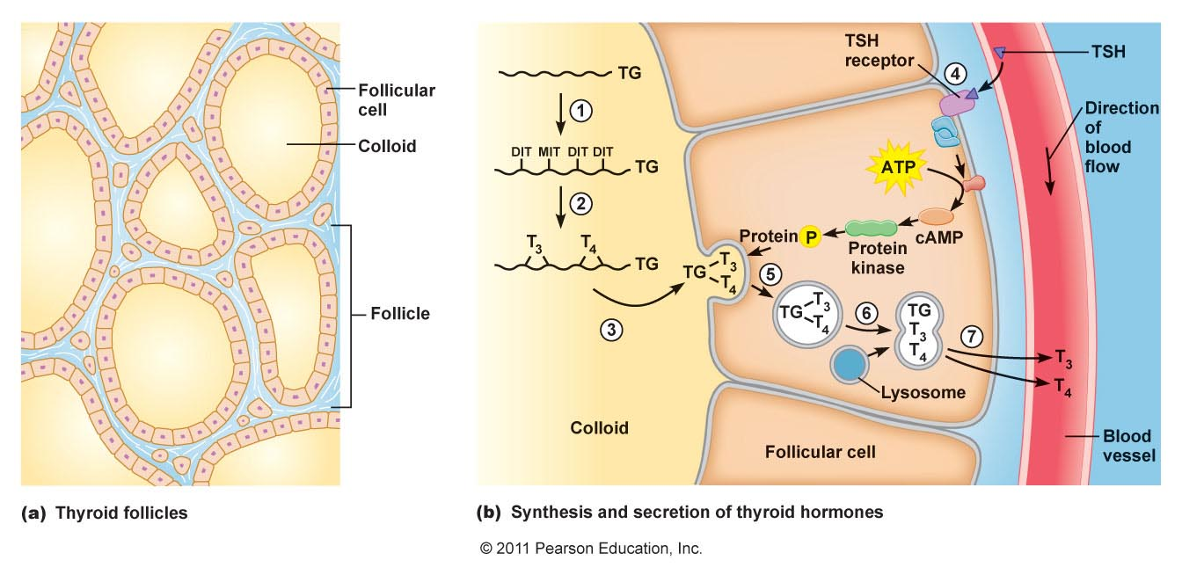
Thyroid Hormone Synthesis
Tyrosine residues of thyroglobulin iodinated
Two iodinated residues join by covalent bond
Thyroid hormones stored in colloid
TSH binds receptor and activates thyroid hormone synthesis
Follicular cells take in thyroglobulin by endocytosis
Endosome fuses with lysosome
Lysosomal enzymes cause release of T3 and T4
T3 and T4 diffuse into bloodstream

Slide 113
Thyroid Gland and Adrenal Gland
Chapter 3: Dr. Beye

Slide 114
Thyroid Gland Disorders
 | Hyperthyroidism | Hypothyroidism
Symptoms | Weight loss Increase HR Sensitive to heat Fidgety, hyperactive, irritable | Weight gain Decrease HR Sensitive to cold Fatigue, depression
Causes | TRH or TSH (leads to Goiter) Grave’s disease: Ab to TSH receptor | TRH TSH Poor diet/iodide deficiency (leads to Goiter) Can also result in atrophy: Autoimmune destruction of thyroid gland

Slide 115
What Questions Do You Have?
You can ask in the Owl forums as well!
Also anonymously ask questions in the online dropbox!!

